Slide 1
Web Application Security Testing the OWASP style
John Vargas – Michael Hidalgo
7th WCSQ Lima, Perú 2017

Slide 2

About us
Michael Hidalgo
Software Engineer and Application Security Expert.
Based in San José, Costa Rica.
Leader OWASP Costa Rica
John Vargas

Slide 3
Agenda
Overview of the HTTP Protocol and Web Technologies
Web Application (In)Security
Mapping the Application
Client-Side Validations Bypass
Common Web Application Vulnerabilities.

Slide 4
Overview of HTTP Protocol and web technologies

Slide 5
The HTTP Protocol
Hypertext Transfer Protocol is the core communication protocol used to access the WWW.
Uses a message-based model where a client sends a request and the server returns a response message.
HTTP is an application layer protocol: It relies on TCP protocol for transport.
HTTP is a stateless protocol.
RFC 2616 "Hypertext Transfer Protocol HTTP/1.1", 1999 @ http://www.ietf.org/rfc/rfc2616.txt.

Slide 6
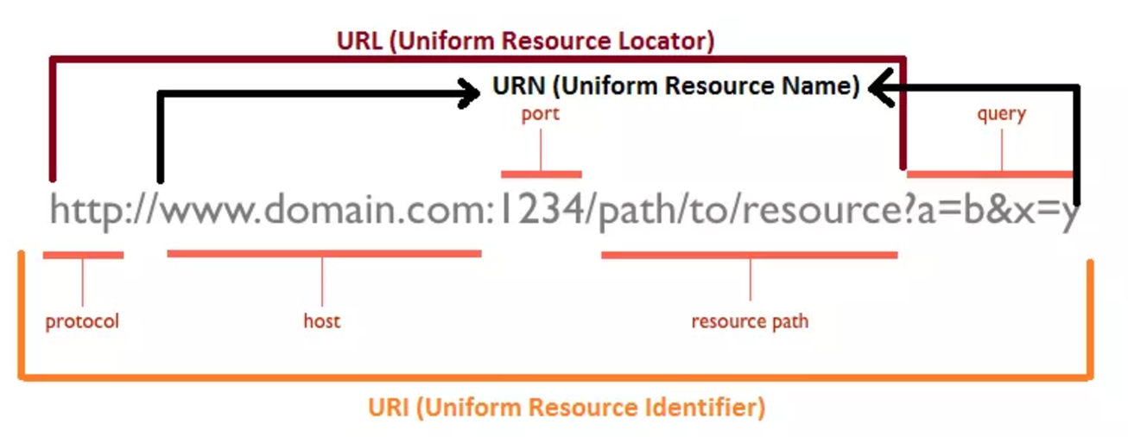
URL, URN, URI: Oh My!
Image taken from: http://webtechsharing.com/http-web-developer-must-know/

Slide 7
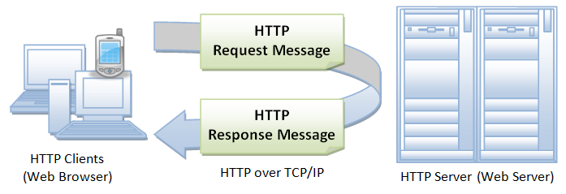
HTTP Illustrated
Image taken from https://www.ntu.edu.sg/home/ehchua/programming/webprogramming/HTTP_Basics.html

Slide 8
General HTTP Headers
Connection: Tells the other end of the communication where it should close the TCP connection
Content-Encoding: Specifies what encoding is being used for the body of the message (e.g gzip).
Content-Length : Specifies the length of the message body in bytes.
Content-Type: Content type contained in the message body.

Slide 9
HTTP Request
HTTP request consist of three items separated by spaces:
HTTP Verb : Indicates the HTTP Method.
Requested URL : URL is the name of the resource being requested.
HTTP version being used.
HTTP Headers:
Referer
User-Agent
Host
Cookies.

Slide 10
Request HTTP Headers
Accept: Tells the server what kinds of content the client is willing to accept.
Accept-Encoding: Tells the server what kind of content encoding the client is willing to accept.
Authorization: Submit credentials to the server.
Cookie: Submit cookies to the server.
Host: Specifies the hostname of the URL.
User-Agent: Browser or client performing the HTTP request.

Slide 11
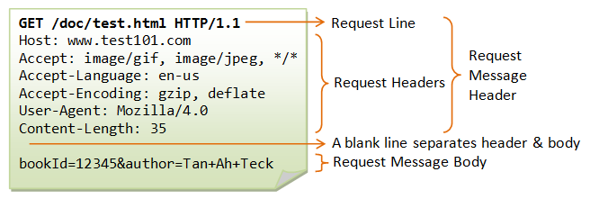
Example HTTP Request
Image taken from https://www.ntu.edu.sg/home/ehchua/programming/webprogramming/HTTP_Basics.html

Slide 12
HTTP RESPONSE
HTTP request consist of the following elements:
HTTP version being used.
Status Code : A numeric value indicating the result of the request.
Server header.
Set-Cookie
Content Length.

Slide 13
Response HTTP Headers
Expires: Tells the browser for how long the content of the body message are valid.
Pragma: Cache directives
Set-Cookie: Issues cookies to the browser
X-Frame-Options: Indicates whether and how the current response may be loaded within a browser.

Slide 14
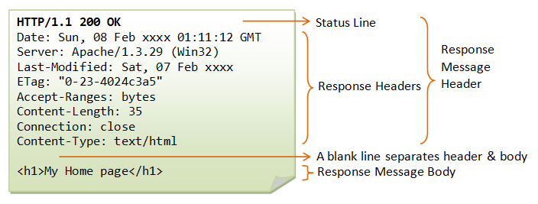
Example HTTP Response
Image taken from https://www.ntu.edu.sg/home/ehchua/programming/webprogramming/HTTP_Basics.html

Slide 15
HTTP Methods

Slide 16
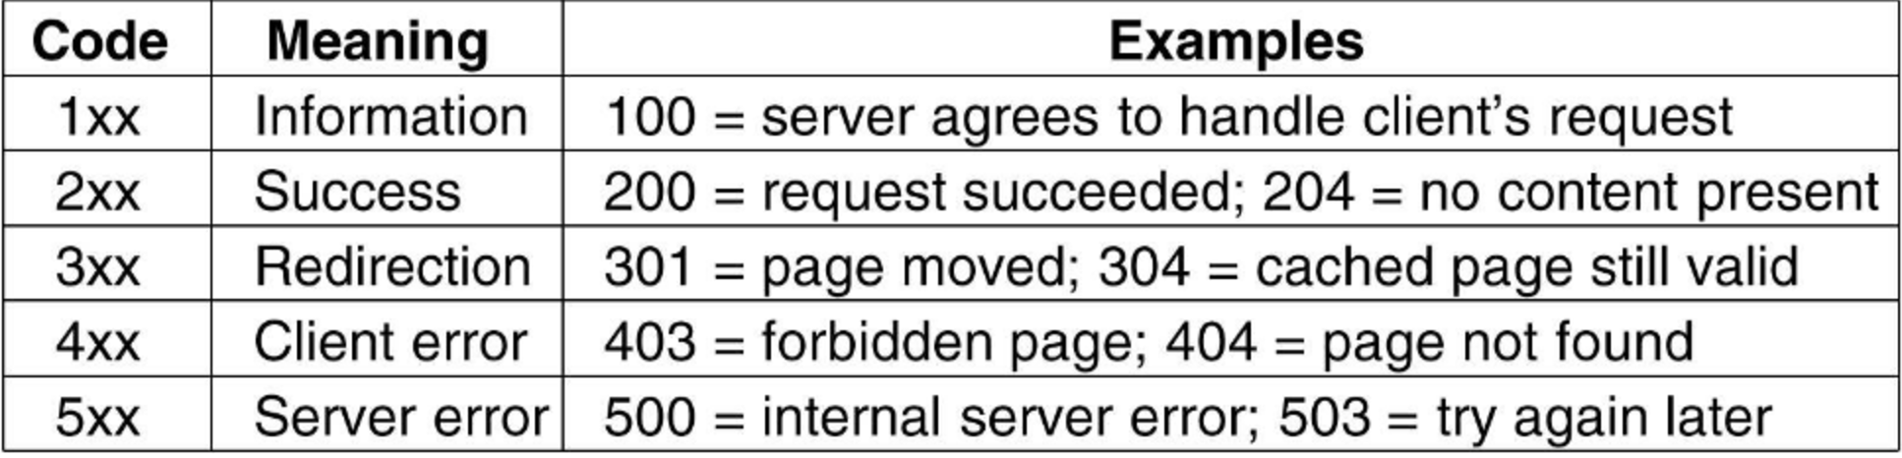
HTTP Status Codes

Slide 17
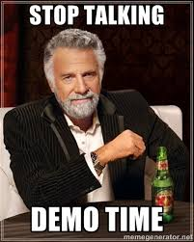

Slide 18
State Management with Cookies
HTTP Is a Stateless Protocol : The request contains all the necessary information for the server to return a response.
With Cookies, the server sends items of data to the client, which the client stores it and resubmits it.
Servers issue a cookie using the Set-Cookie HTTP header.
Frequently used as a vehicle for exploiting vulnerabilities.

Slide 19
Anatomy of a Cookie
Expires: Sets a date until which the cookie is valid.
Domain: Specifies the domain for which the cookie is valid.
Secure: When this attribute is set, the cookie will be submitted only in HTTPS.
HttpOnly: When this attribute is set, the cookie cannot be accessed from Client Side code (a.k.a JavaScript).

Slide 20
Web application (IN)Security

Slide 21
Core Problem : Input Data Validation
URL
Form fields
GET Parameters
POST Payloads
HTTP Headers
Web Services
Cookies
External Services
Database

Slide 22
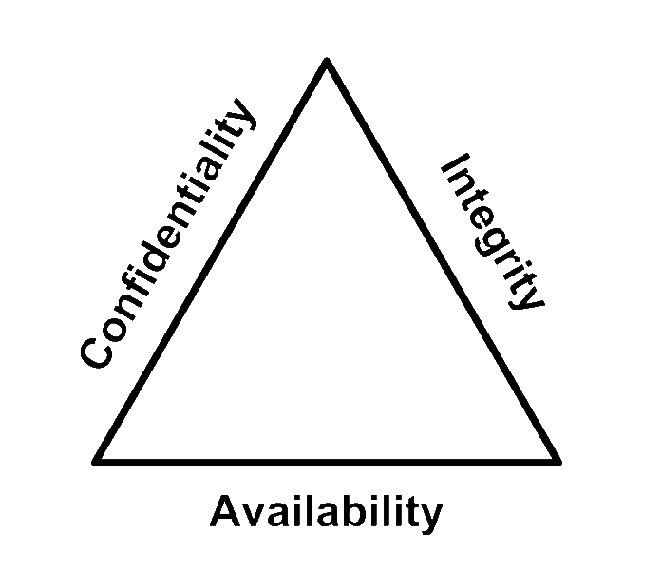
CIA Triad

Slide 23

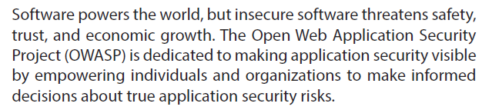
Who is OWASP?
Notes:
OWASP is a global community that drives the visibility and evolution in the safety and security of the world’s software.
Everyone is free to participate in OWASP and all of our materials are available under a free and open software licenses.
OWASP is a registered nonprofit in the United States and Europe, so all of your financial contributions are tax deductible.

Slide 24
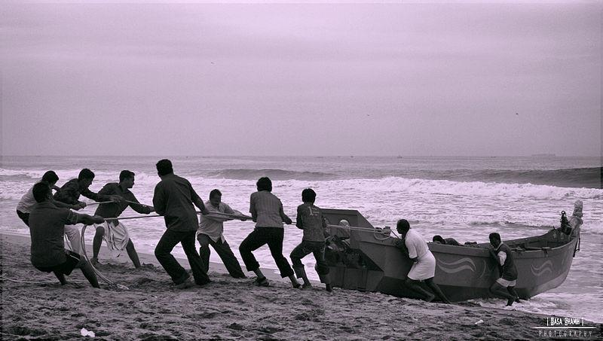
The value of volunteerism
Notes:
A recent survey carried out by TimeBank through Reed Executive showed that among 200 of the UK's leading businesses
94% think volunteering adds to the skills of their workforce
58% say voluntary work can be more valuable than experience gained in paid employment
25% offer paid time off to employee volunteers
15% allow sabbaticals for volunteering projects.
Employer supported volunteering can help a company’s:
Reputation and credibility
Recruitment and staff retention
Staff morale and work performance
Training and development
Change management
Government and regulatory relations.

Slide 25
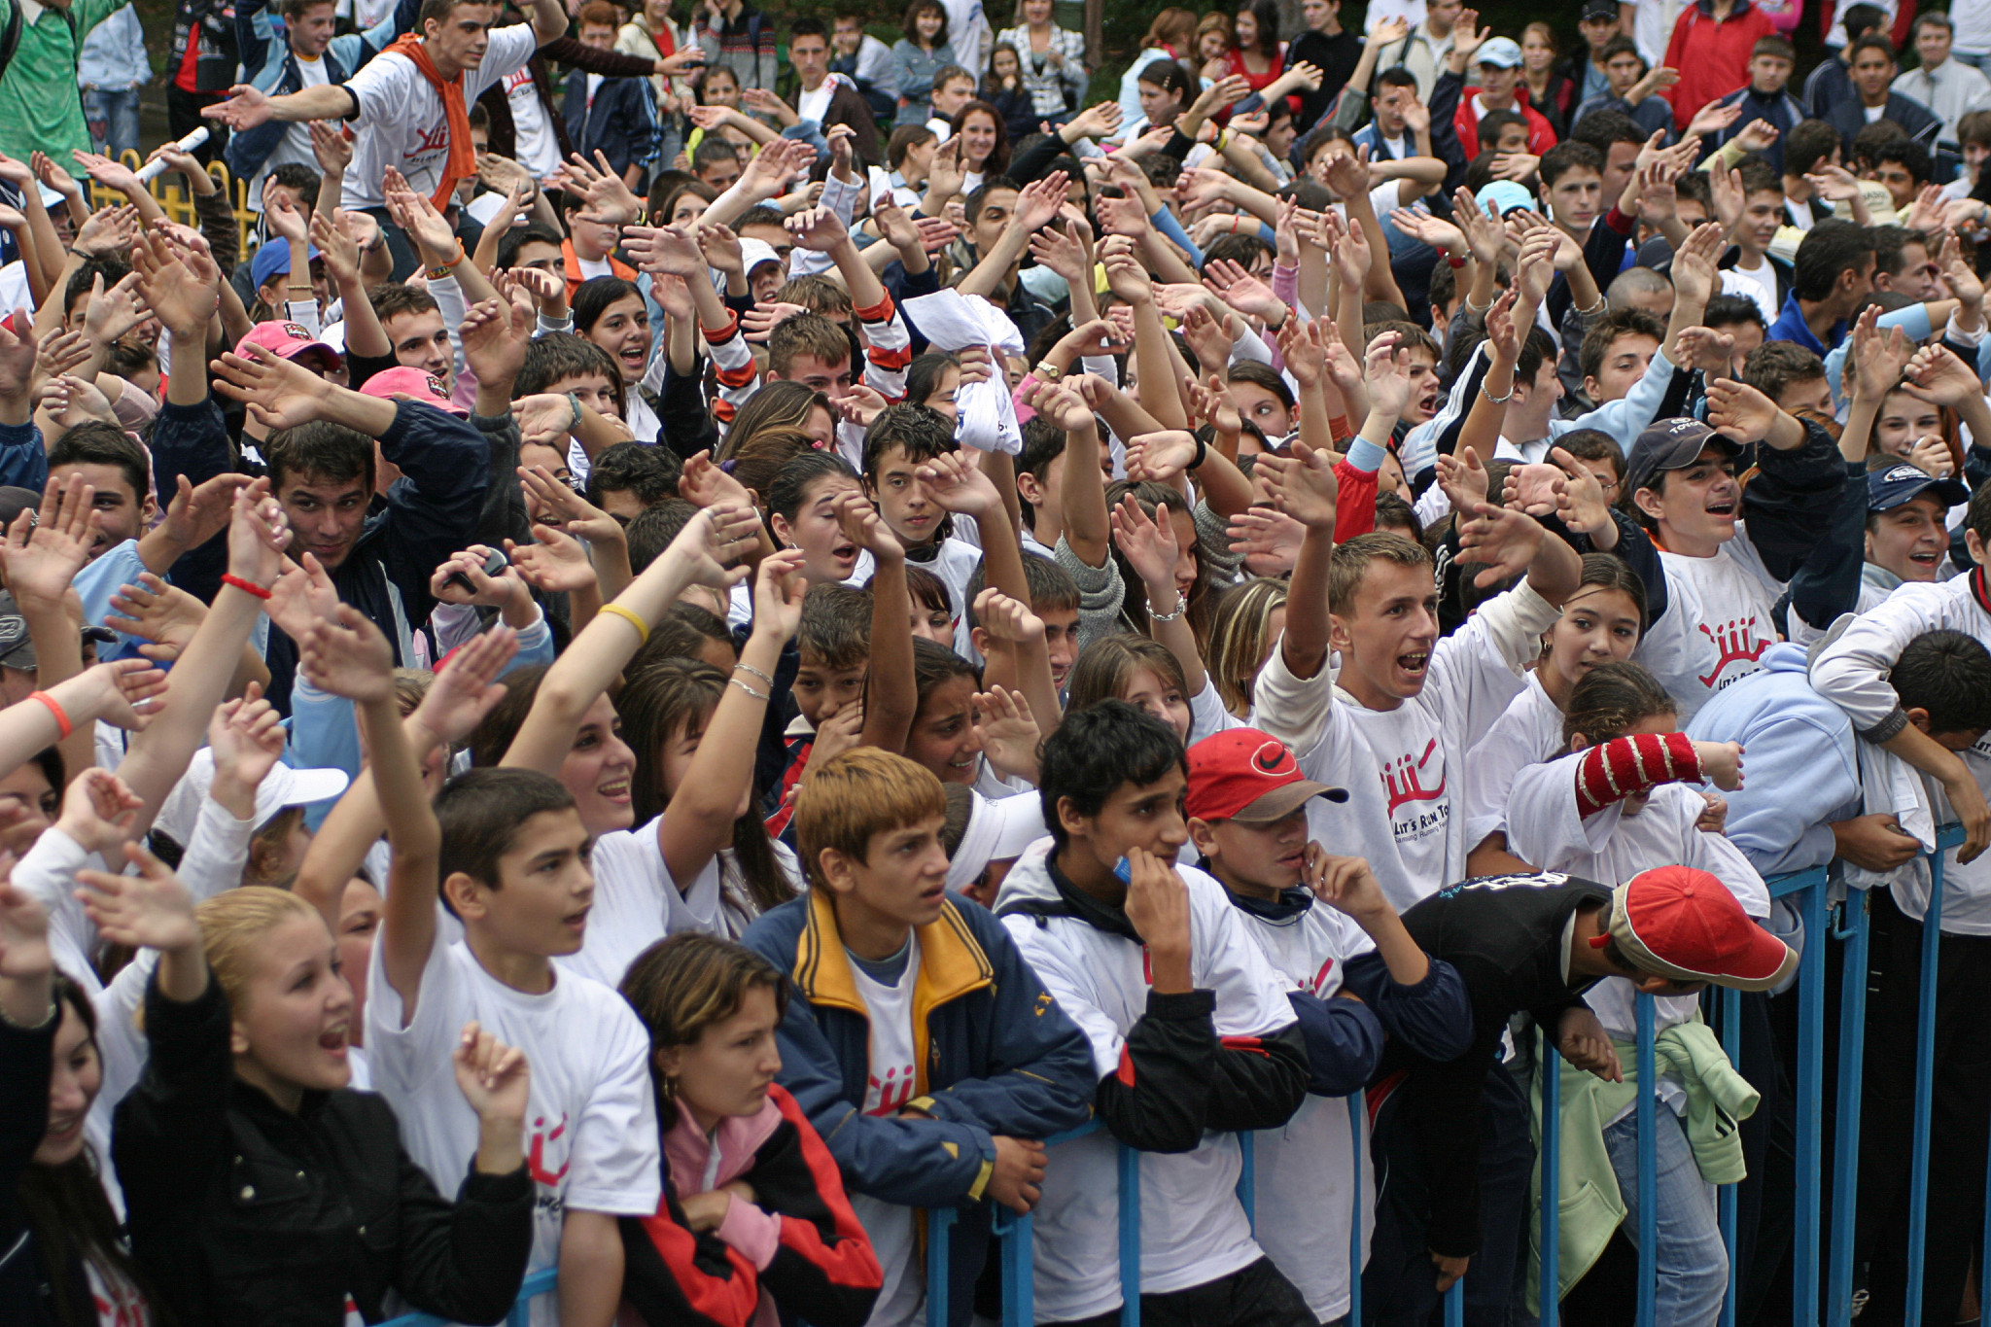
Show of hands
Notes:
NOTE: Gathering demographic information helps owasp to increase sponsorship please pass what you learn onto Paul.Ritchie@owasp.org.
Now that you know a bit about OWASP, we would like to know a bit about you. Demographics from developers to CIO's are important to highlight as the community has many people that make it successful. By show of hands:
First OWASP Meeting, Event, Conference?
Volunteer Project Leaders?
Volunteer Chapter Leaders?
Commercial
Government
Developers?
Architects?
Pen-testers?
CIO's?
Question
Has the OWASP Foundation provided your corporation or professional value with guides, tools and community?

Slide 26

16
Years of community service
Notes:
13 Years YOUNG is the collective group. We have many groups popping up around us like IEEE, BSides, ISSA, ISACA, ISC2, Defcon, 2600 etc... we share one common bond - community. (Jan 2001-Current)
What will software look like in 20 years?

Slide 27

OWASP's DNA
Notes:
OWASP values people over profits.
And we derive our core values from this DNA. OWASP's Core Values are:
OPEN Everything at OWASP is radically transparent from our finances to our code.
INNOVATION OWASP encourages and supports innovation/experiments for solutions to software security challenges.
GLOBAL OWASP is inclusive not exclusive. Anyone around the world is free to participate in the OWASP community.
INTEGRITY OWASP is an honest and truthful, vendor agnostic, global community.

Slide 28
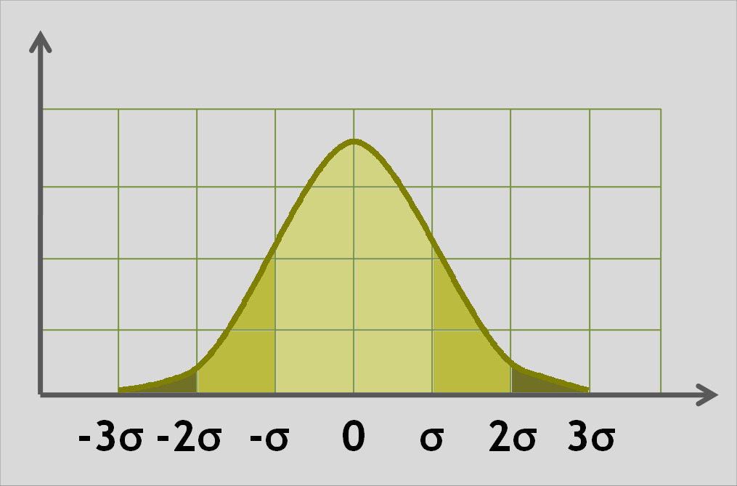
OWASP
by the numbers
Notes:
NOTES TO SPEAKER:
Slides 5-19 are intended to be gone through quickly.
This is why there are limited speaker notes.
The speaker is free to comment about each of the slides / ideas as the speaker chooses.

Slide 29

2,611,000
owasp.org page views (per month)
Notes:
Thanks to Javascipt and Google Analytics ;)
2013: 1,370,000

Slide 30
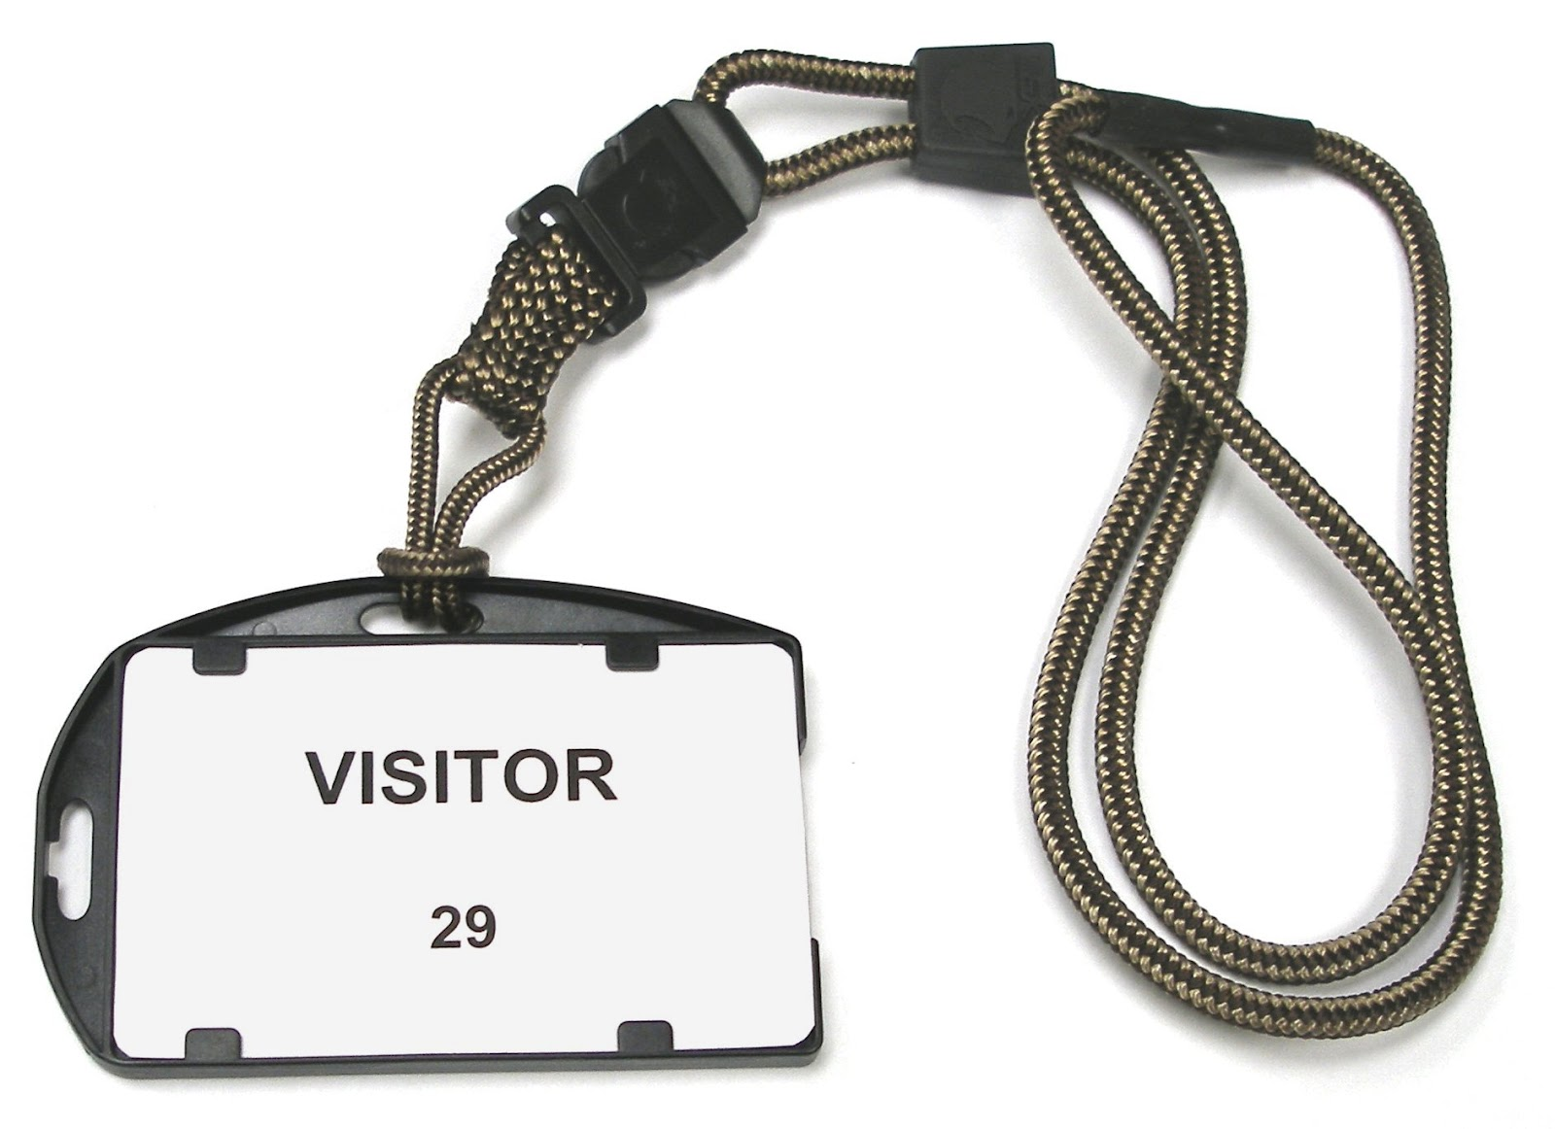
1,447,000
owasp.org unique visitors per month
Notes:
2013: 400,100

Slide 31
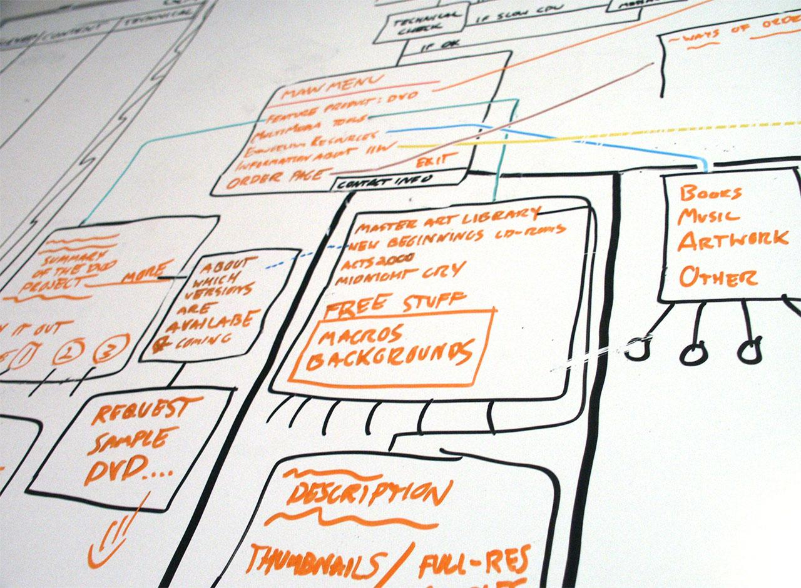
126
Active Projects
Notes:
From Johana’s 2015 report as of March.
Current Active Projects: 126
Incubator - 97
Labs - 26
Flagship - 3
Projects by Type:
19 Code projects
40 Documentation Projects
53 Tool Projects

Slide 32
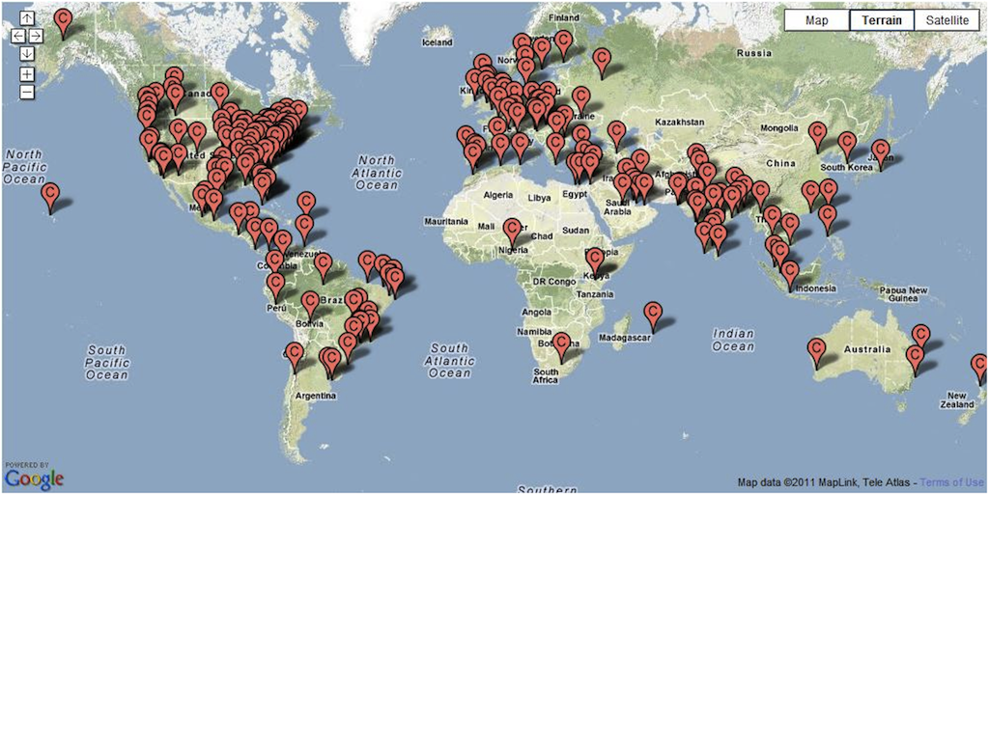
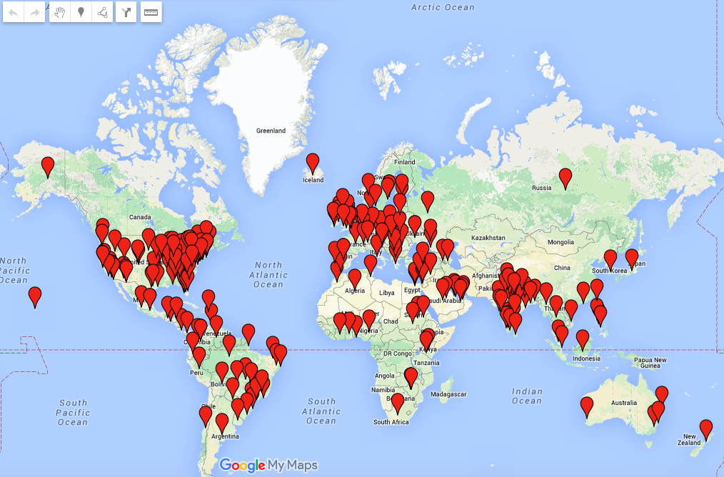
268
Active Chapters
Notes:
From Sarah’s roll-up report August 11 2013.
New Chapters August 2013: 1
Azerbaijan (Middle East) - lead by Adil Aliyev
How many countries?
as of 4/2/2015
102 as of 10/30/2013

Slide 33

44,000+
participants mailing lists
Notes:
Updated to 36k - TJB 19-Feb
2013: 43,000
ye2014: 44,000

Slide 34

129+
Government & Industry Citations!
Notes:
Does Industry & Government think our materials are creditable?
NOTE: pick a few that you find interesting, (delete the rest) no need to name them all...
Canadian Cyber Incident Response Centre, Center for Internet Security (CIS), Centre for the Protection of National Infrastructure (CPNI), Cloud Security Alliance (CSA), Defense Information Systems Agency (DISA), European Network and Information Security Agency (ENISA), Federal Financial Institutions Examination Council (FFIEC), Federal Trade Commission (FTC), Financial Services Roundtable, GovCertUK, Institute of Electrical and Electronics Engineers (IEEE), International Organization for Standardization (ISO) and International Electrotechnical Commission (IEC), National Cyber Security Division, National Institute of Standards and Technology (NIST), National Security Agency/Central Security Service, Payment Card Industry Security Standards Council (PCI SSC), SANS Institute, Software Engineering Institute (SEI), Trusted Information Sharing Network for Critical Infrastructure Protection (TISN), World Wide Web Consortium (W3C), Australian Computer Emergency Response Team (AusCERT), Canadian Cyber Incident Response Centre, Combined Security Incident Response Team (CSIRTUK), Information Assurance Technology Analysis Center (IATAC), Data and Analysis Center for Software (DACS).
And in September the Department of Homeland Security (DHS)!
88 as of 2013
126 as of 03/31/2015
Source:
https://www.owasp.org/index.php/Industry:Citations

Slide 35

9
Academic Supporters
Notes:
Are you a alumni? Do you give back to your college - bring them OWASP via or Academic Supporters program. Academics supporters provide space for chapter or student chapter meetings and provide feedback on our educational materials as well as conversation around application security curriculum development.
We are currently revising our Academic Supporters program. In the past we have had over 100 universities and schools listed as academic supporters.
8 reported active/confirmed as of 3/31/2015

Slide 36
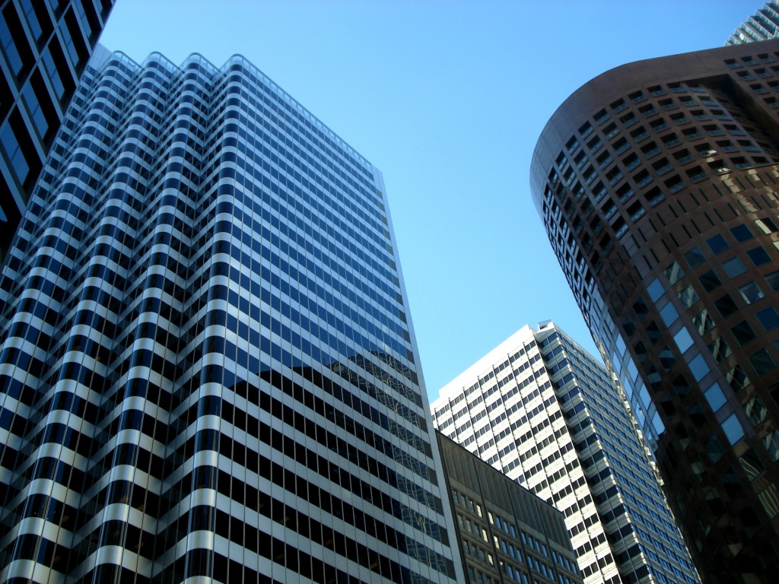
55
Paid Corporate Memberships
Notes:
Corporate Supporters -- Industry providers such as UPS, BestBuy, HP, Oracle, Twitter, and many technology service providers including Rackspace thank you for hosting the website btw (count from https://www.owasp.org/index.php/Main_Page)
Source: https://www.owasp.org/index.php/February_2015_Membership_Report

Slide 37
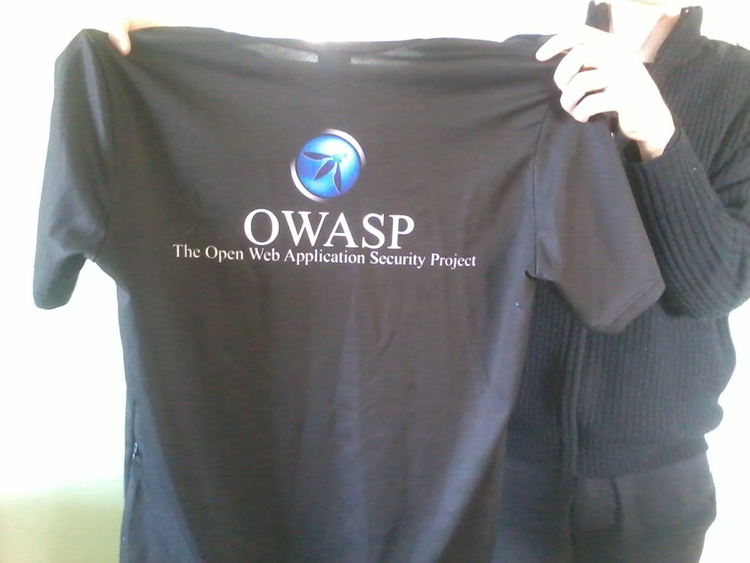
2268
Individual Members
Notes:
http://owasp.com/index.php/July_2013_Membership_Report

Slide 38

Contact Us
support@owasp.org
www.owasp.org
Notes:
This event is more than a bunch of speakers presenting slides you should see this in the hallways and after the sessions are over. People sitting down to
work together on projects big and small. If your like the rest of us, you don't need more email so take the time to introduce yourself and provide feedback.

Slide 39
OWASP Top 10
A1: Injection
A4: Insecure Direct Object References
A2:Broken Authentication and Session Management
A10: Unvalidated Redirects and Forwards
A3: Cross-Site Scripting (XSS)
A7: Missing Function Level Access Control
A5:Security Misconfiguration
A6: Sensitive Data Exposure
A8: Cross Site Request Forgery (CSRF)
A9: Using Components with known vulnerabilities

Slide 40
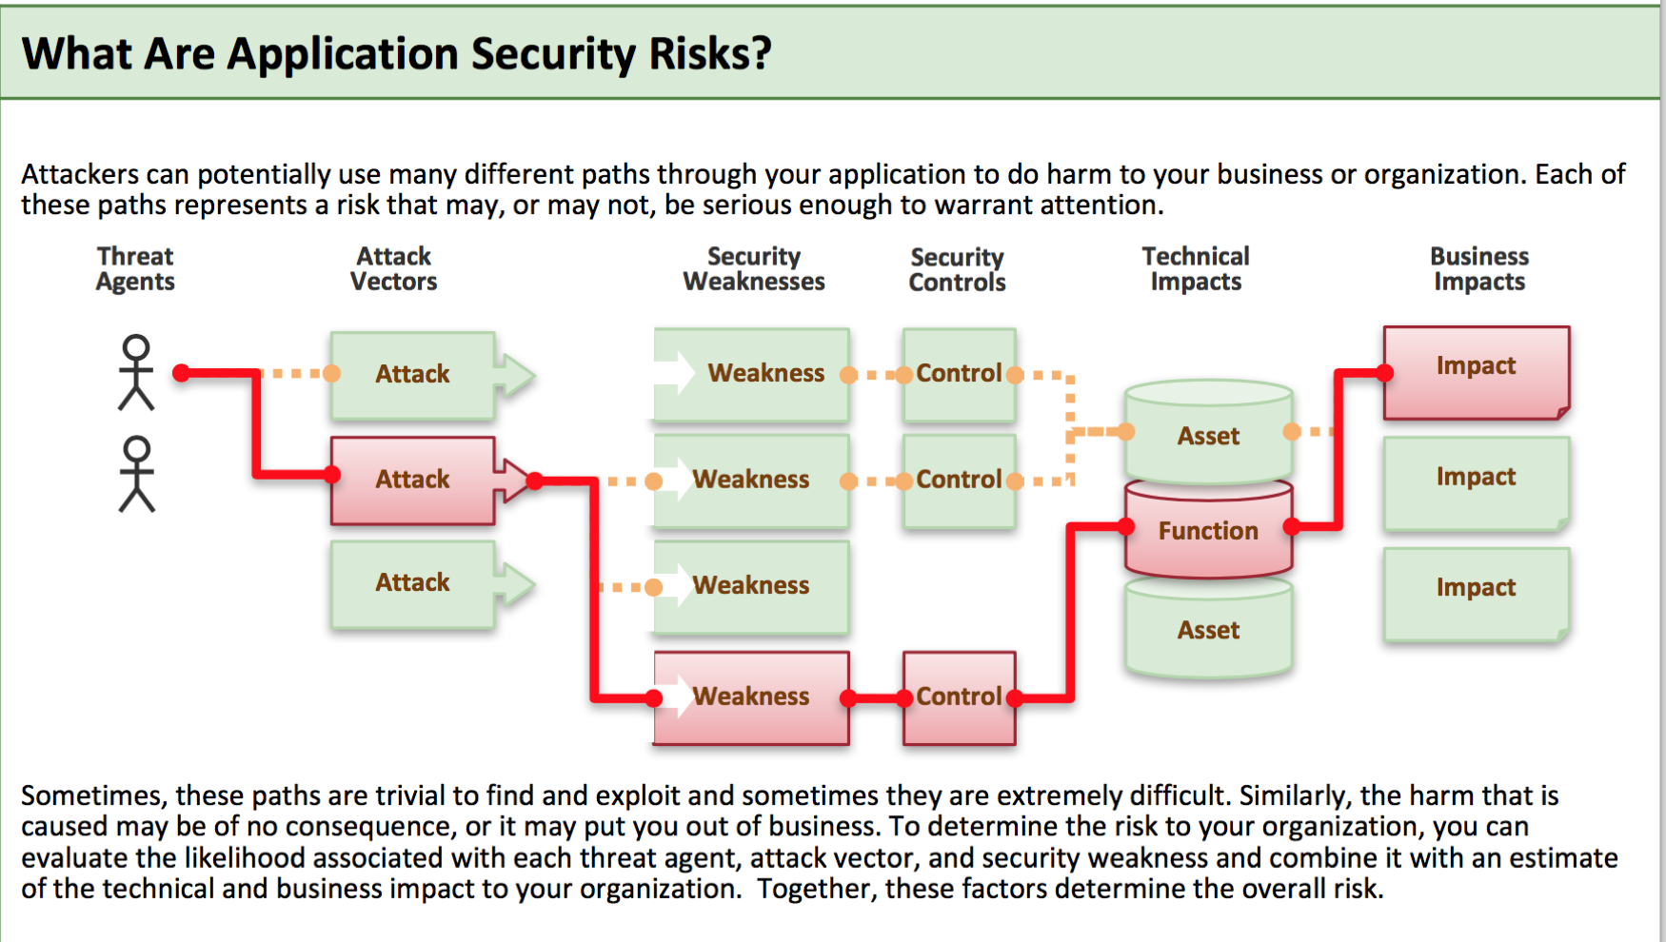

Slide 41
A1 – Injection
Injection means…
Tricking an application into including unintended commands in the data sent to an interpreter
Interpreters…
Take strings and interpret them as commands
SQL, OS Shell, LDAP, XPath, Hibernate, etc…
SQL injection is still quite common
Many applications still susceptible (really don’t know why)
Even though it’s usually very simple to avoid
Typical Impact
Usually severe. Entire database can usually be read or modified
May also allow full database schema, or account access, or even OS level access

Slide 42
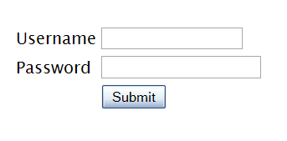
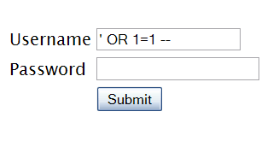

"SELECT * FROM accounts WHERE acct=‘’ OR 1=1--’"
Account Summary
Acct:5424-6066-2134-4334
Acct:4128-7574-3921-0192
Acct:5424-9383-2039-4029
Acct:4128-0004-1234-0293
Account:
Account:
SKU:
DB Table 

SKU:
HTTP response 

HTTP request
Finance
SQL query
Transactions
Accounts
Administration
Communication
Knowledge Mgmt
E-Commerce
Bus. Functions
Databases
Legacy Systems
Web Services
Directories
Billing
Application Layer
Human Resrcs
APPLICATION ATTACK
Custom Code
1. Application presents a form to the attacker
2. Attacker sends an attack in the form data
App Server
3. Application forwards attack to the database in a SQL query
Web Server
Hardened OS
4. Database runs query containing attack and sends encrypted results back to application
Network Layer
Firewall
Firewall
5. Application decrypts data as normal and sends results to the user
Notes:
Main Point
The flow of a SQL injection attack goes from attacker to application to database, then back.
Teaching Points
SQL injection is a simple attack that exploits the trust relationship between the database and the application. In essence, the attacker tricks the application into sending the wrong query to the database. The database trusts the application, and so complies with the request.
Even if the data is encrypted in the database, this type of attack can access the data. In the example depicted above, the attacker sends an attack in the data that tricks the database into returning all the credit cards from the database instead of only one. Normally, the application would decrypt the account owner’s credit card number (or other sensitive data) and display it. When attacked, the application decrypts all the card numbers and displays them all to the attacker.
Examples, Demonstrations, Stories, Notes

Slide 43
A1 – Avoid Injection Flaws
Recommendations
Avoid the interpreter entirely, or
Use an interface that supports bind variables (e.g., prepared statements, or stored procedures),
Bind variables allow the interpreter to distinguish between code and data
Encode all user input before passing it to the interpreter
Always perform ‘white list’ input validation on all user supplied input
Always minimize database privileges to reduce the impact of a flaw
References
For more details, read the new http://www.owasp.org/index.php/SQL_Injection_Prevention_Cheat_Sheet

Slide 44
A2 – Broken Authentication and Session Management
HTTP is a “stateless” protocol
Means credentials have to go with every request
Should use SSL for everything requiring authentication
Session management flaws
SESSION ID used to track state since HTTP doesn’t
and it is just as good as credentials to an attacker
SESSION ID is typically exposed on the network, in browser, in logs, …
Beware the side-doors
Change my password, remember my password, forgot my password, secret question, logout, email address, etc…
Typical Impact
User accounts compromised or user sessions hijacked

Slide 45
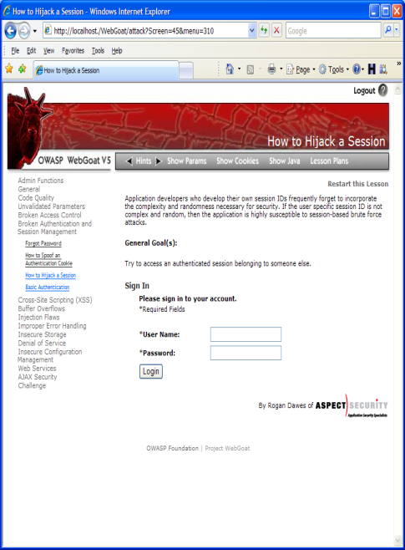
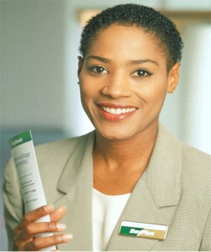
1
User sends credentials
Finance
Transactions
Accounts
Administration
Communication
Knowledge Mgmt
E-Commerce
www.boi.com?JSESSIONID=9FA1DB9EA...
Bus. Functions
Site uses URL rewriting
(i.e., put session in URL)
2
Custom Code
3
User clicks on a link to http://www.hacker.com in a forum
Hacker checks referer logs on www.hacker.com
and finds user’s JSESSIONID
4
5
Hacker uses JSESSIONID and takes over victim’s account

Slide 46
A2 – Avoiding Broken Authentication and Session Management
Verify your architecture
Authentication should be simple, centralized, and standardized
Use the standard session id provided by your container
Be sure SSL protects both credentials and session id at all times
Verify the implementation
Forget automated analysis approaches
Check your SSL certificate
Examine all the authentication-related functions
Verify that logoff actually destroys the session
Use OWASP’s WebScarab to test the implementation

